Slide 1


Slide 2
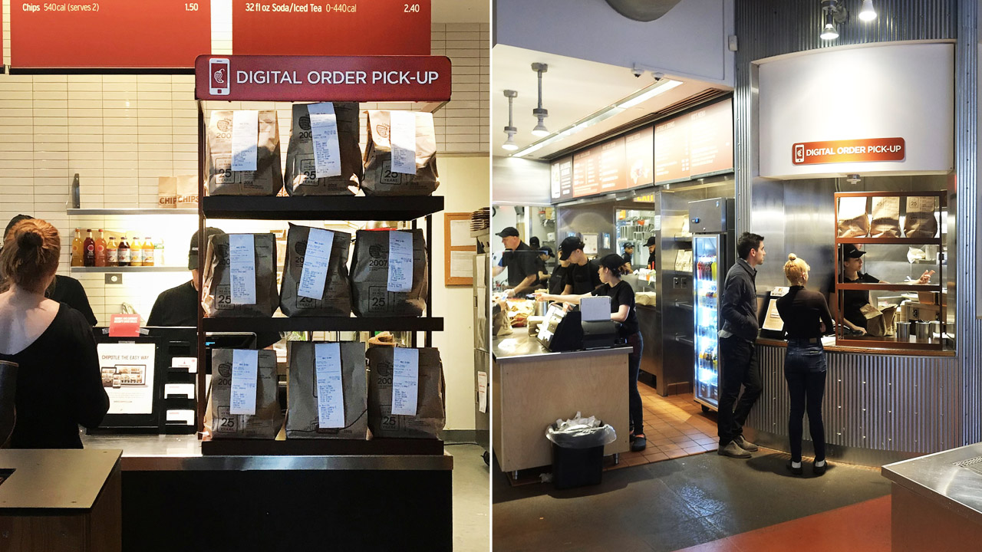

Slide 4
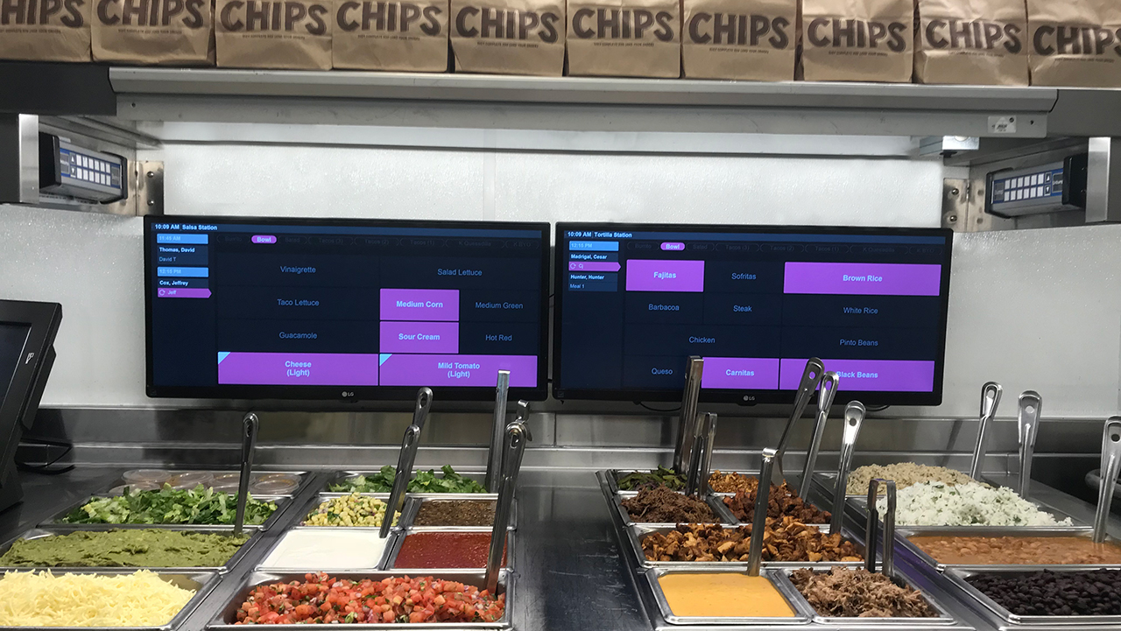

Slide 6


Slide 8
CHROME USERS REMINDER:
CLICK ON NEXT SLIDE TO PLAY VIDEO

Slide 9
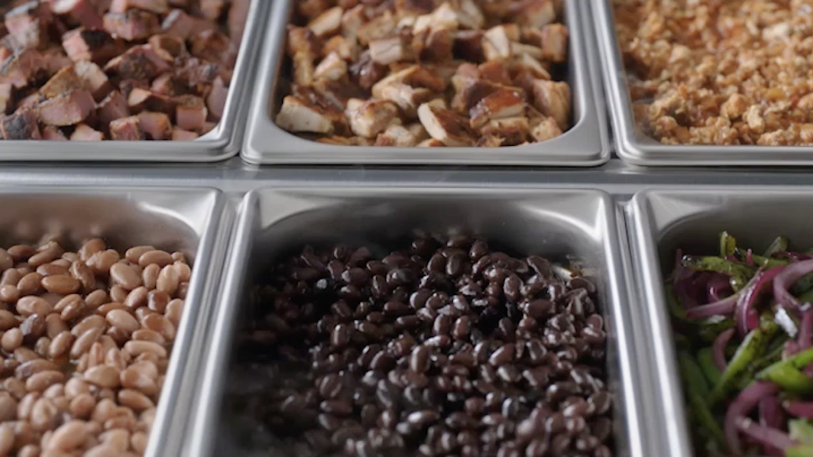

Slide 11
CHROME USERS REMINDER:
CLICK ON NEXT SLIDE TO PLAY VIDEO

Slide 12


