Slide 2
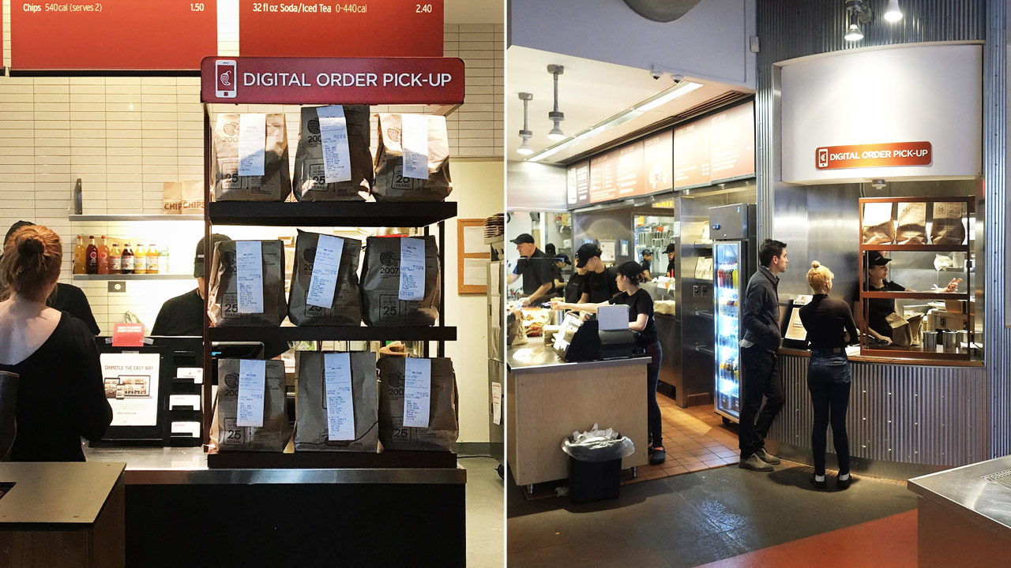

Slide 4
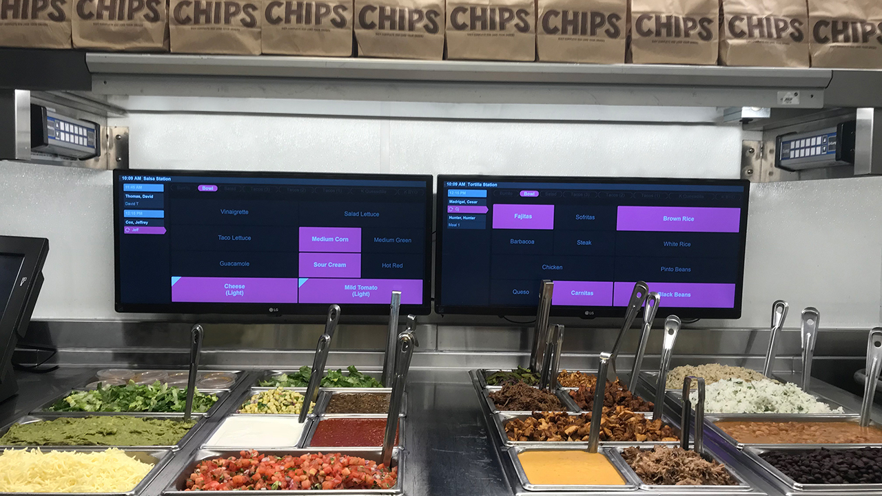

Slide 8
CHROME USERS REMINDER:
CLICK ON NEXT SLIDE TO PLAY VIDEO

